Slide 1
Combinational Circuits

Slide 2

Combinational Circuits
We have designed a circuit that implements the Boolean function:
This circuit is an example of a combinational logic circuit.
Combinational logic circuits produce a specified output (almost) at the instant when input values are applied.

Slide 3
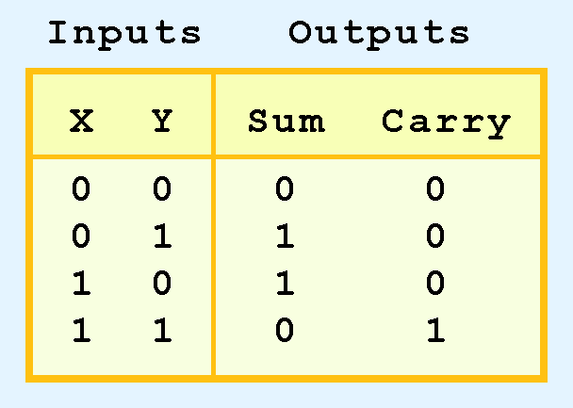
Combinational Circuits
Combinational logic circuits give us many useful devices.
One of the simplest is the half adder, which finds the sum of two bits.
We can gain some insight as to the construction of a half adder by looking at its truth table, shown at the right.

Slide 4
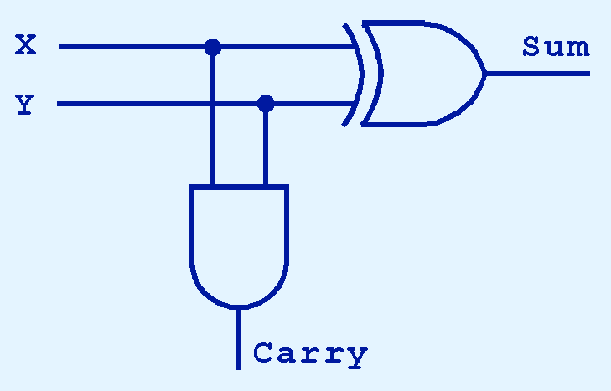
Combinational Circuits
As we see, the sum can be found using the XOR operation and the carry using the AND operation.

Slide 5
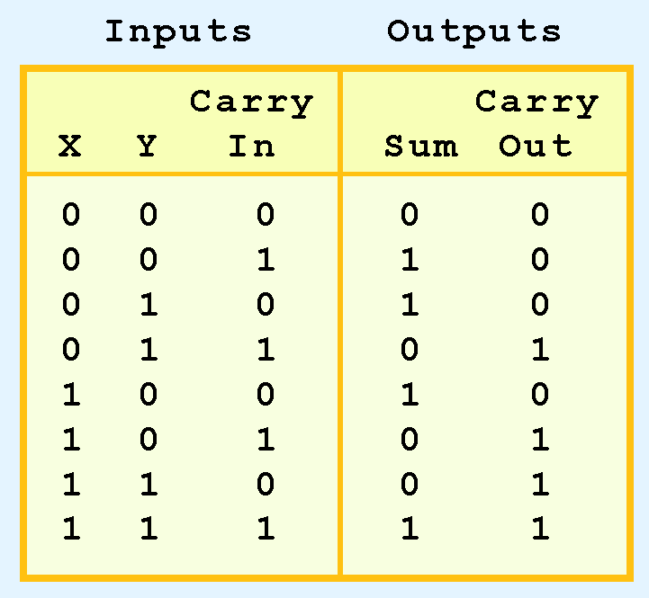
Combinational Circuits
We can change our half adder into to a full adder by including gates for processing the carry bit.
The truth table for a full adder is shown at the right.

Slide 6
Combinational Circuits
How can we change the half adder shown below to make it a full adder?

Slide 7
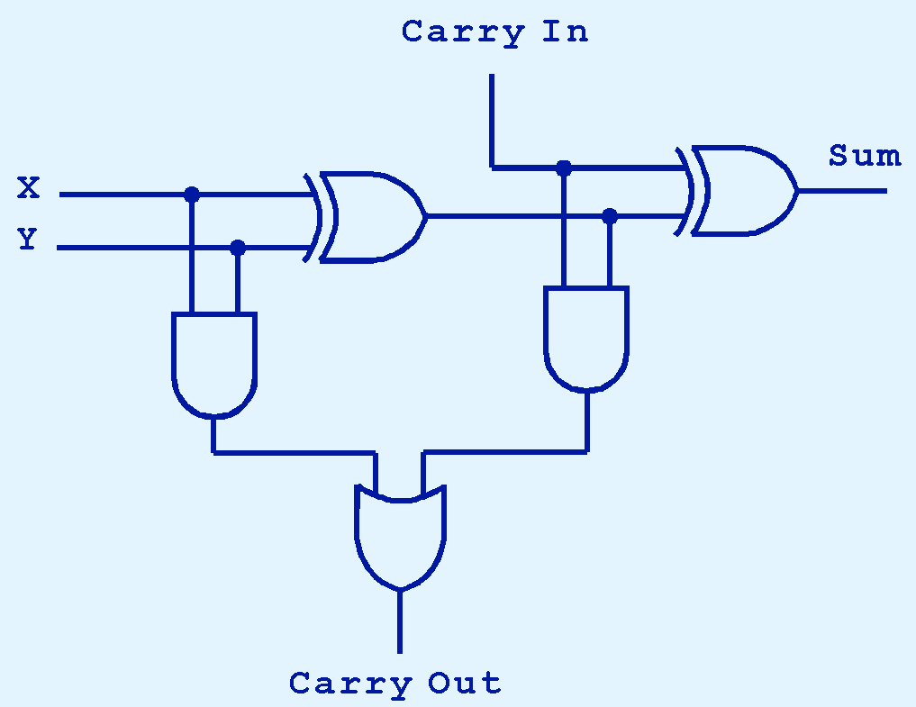
Combinational Circuits
Here’s our completed full adder.

Slide 8

Combinational Circuits
Just as we combined half adders to make a full adder, full adders can connected in series.
The carry bit “ripples” from one adder to the next; hence, this configuration is called a ripple-carry adder.
Today’s systems employ more efficient adders.

Slide 9
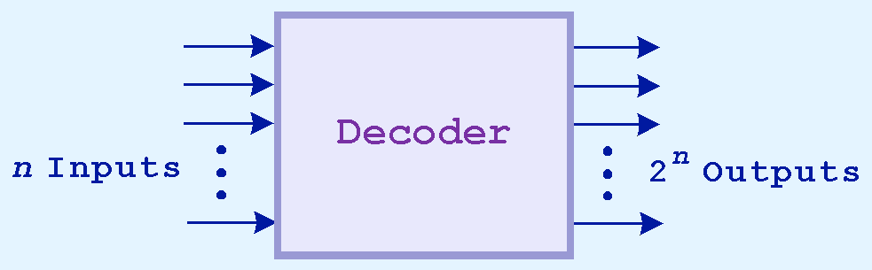
Combinational Circuits
Decoders are another important type of combinational circuit.
Among other things, they are useful in selecting a memory location according a binary value placed on the address lines of a memory bus.
Address decoders with n inputs can select any of 2^{n} locations.
This is a block diagram for a decoder.

Slide 10
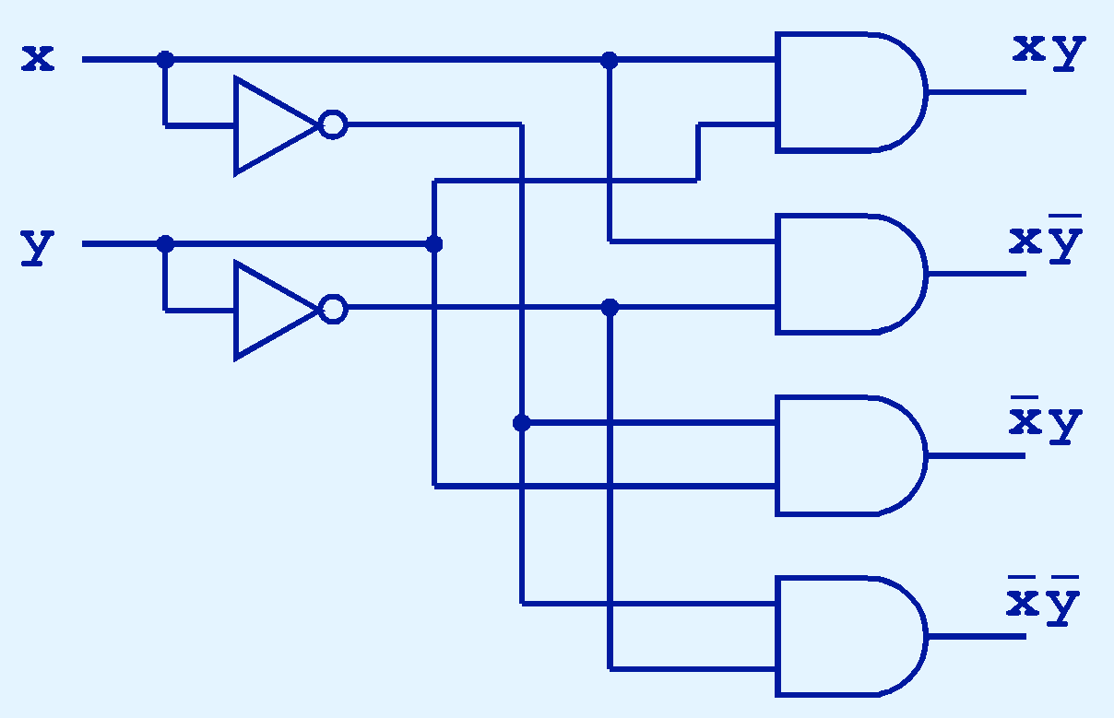
Combinational Circuits
This is what a 2-to-4 decoder looks like on the inside.
If x = 0 and y = 1, which output line is enabled?

Slide 11


Slide 12
Conclusion
The behavior of sequential circuits can be expressed using characteristic tables or through various finite state machines.
Examples of sequential circuits include Half adder, full adder, decoders.

Slide 13
Problems
Q. 1. How many number of Half adder are required to design a Full adder circuit?
Q2. How many number of EXOR and AND gates are required to design a Half adder?
Q 3. How many EXOR and AND and OR gates are required to design a Full adder circuit?

Slide 14
Problems
Q. 4. How many number of full adders are needed to add two 8-bit numbers?
Q 5. write the sum and carry output of Half adder circuit
Q 6. Write the Sum and carry output of full adder circuit.

Slide 15
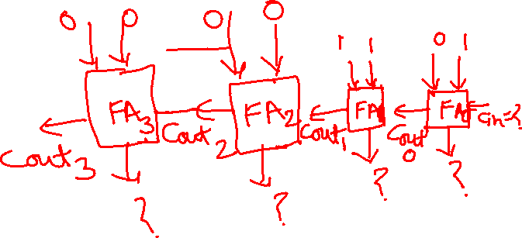
Problems
Q. 7. show the steps to add following two 4-bit numbers using full adder circuit.
0011
0010
What is the value
Of Different Cout
And differnet?

Slide 16
Thanks

